Slide 1
Data Mining and Text Mining - Final Project
By:
Kyle Dean, Kaitlyn Scheppa, Orel Yoshia

Slide 2
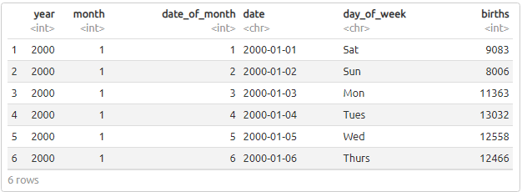
Our Dataset
Notes:
The dataset we used is us_births_00_14 dataset, containing the births recorded in America from the beginning of 2000 to the end 2014. It has the total births for each date listed

Slide 3
Births per Year

Slide 4
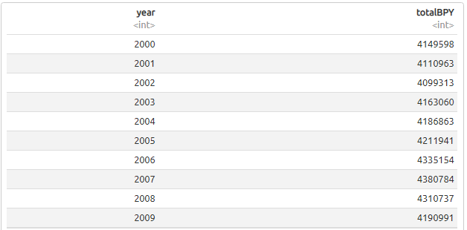

Analysis
Data frame of total Births by Year
Notes:
The number listed above in ‘totalBPY’ represent the total births per year from 2000 to 2014. We use this data frame to to view the highest and lowest total births for each year.

Slide 5
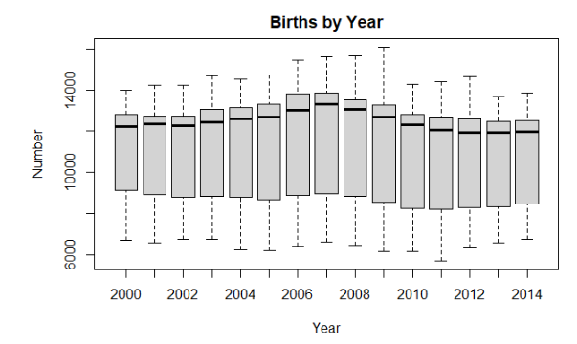
Results
Box plot of Births by Year
Notes:
boxplot showing the total number of births from each year from the year 2000 to 2014. The e year with the highest births on a day is from 2009, and the lowest is in 2013,

Slide 6
Births per Day

Slide 7
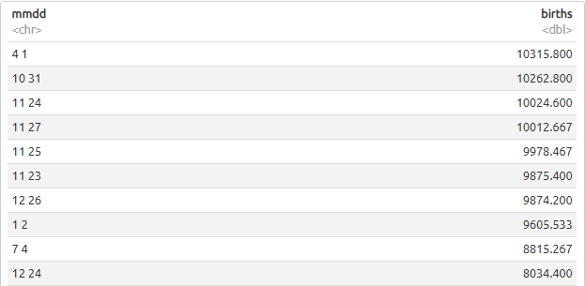

Analysis
Data frame for average births on a specific date sorted by the lowest average.
Notes:
Mmdd is the combination of Month and Day of a Month.
These are the results from the mmdd subset showing the average number of births for that day over the 15 years.

Slide 8
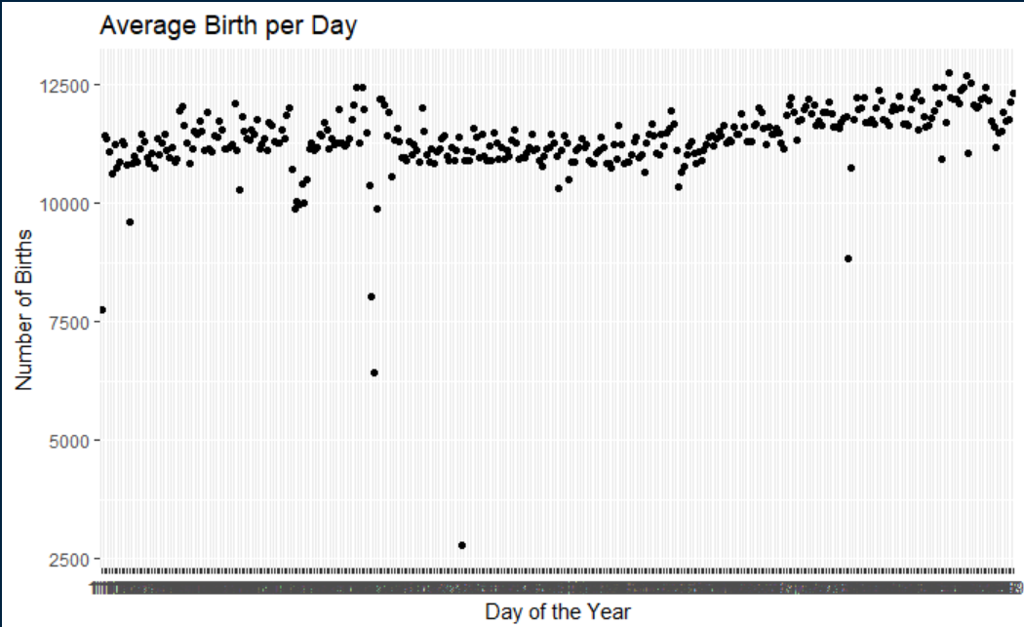
Results
Scatter plot of the data frame
Notes:
This is a visualization of the average births per date. We took each date in a year and averaged it between the 15 years and created a scatter plot above. As seen on this plot, there are 366 points on this graph. Each point represents the average of each date in a year. While most dates hover between 10,000 and 12,500, there are a few dates with an extremely low average of births.

Slide 9
Days of the Week

Slide 10
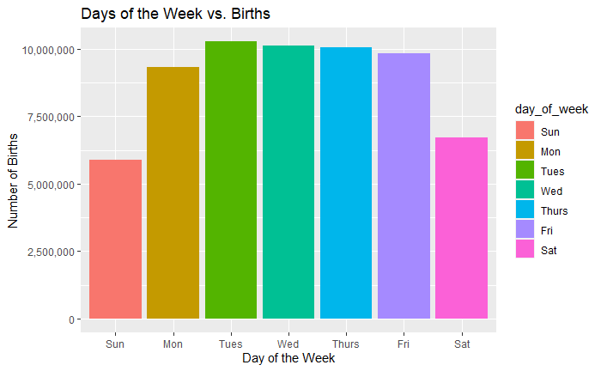
Results
Bar graph of the total number of births on each day of the week
Notes:
In this display, we see a stark difference in number of births between weekdays and weekends

Slide 11
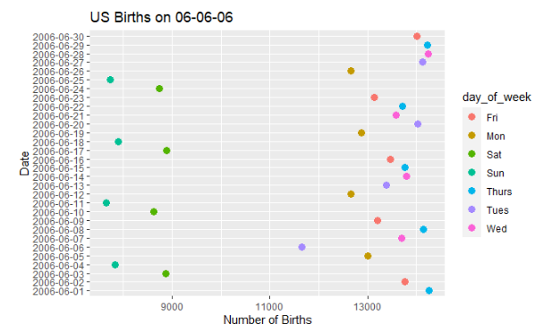
Results
Scatter Plot representing US births on June 06, 2006

Slide 12
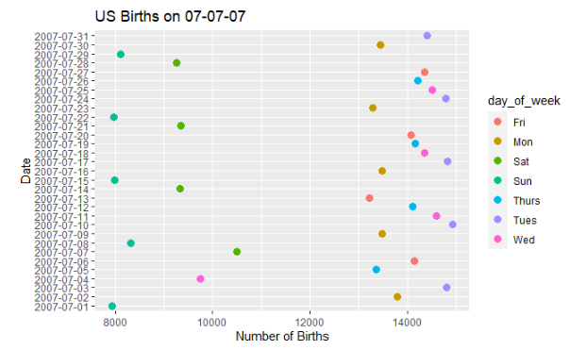
Results
Scatter Plot representing US births on July 07, 2007

Slide 13
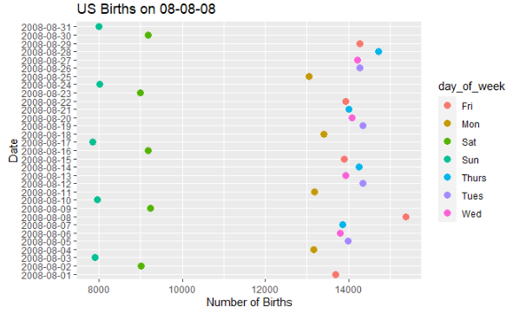
Results
Scatter Plot representing US births on August 08, 2008

Slide 14
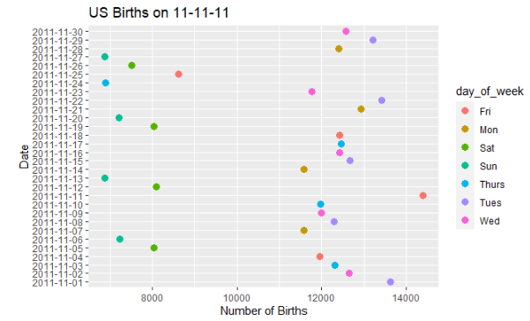
Results
Scatter Plot representing US births on November 11, 2011

Slide 15
Conclusion
The highest births per year from 2000 to 2014 was in the year 2009 and the lowest was in the year 2013.
The average date that had the lowest amount of births was right before, during, and after major holidays. The lowest was also February 29th because it is a leap year that only happened 4 times between 2000 and 2014.
Days of the week are highly correlated to when people give birth. Weekends had the lowest average births.
Cool dates like 07/07/07 and 11/11/11 can make a difference in the amount of births but if they fell on a weekend, it will definitely affect the results.

Slide 16
Thank You
Hope you enjoyed learning about Births of Babies in the US!

Slide 17

Link to GitHub
Click on baby below for the link to our GitHub Page

